Slide 1
Compliance Automation with InSpec
Nathen Harvey - @nathenharvey

Slide 2
Learning Lab

Slide 3

Join Slack Team & Channel
http://community-slack.chef.io
#CHANNEL-NAME
#CHANNEL-NAME
Notes:
>>> INSTRUCTOR NOTE – Update the slack channel name

Slide 4
Find your IP Address

Slide 5
Login to remote workstation
ssh chef@IP_ADDRESS
The authenticity of host '52.54.113.210 (52.54.113.210)' can't be established.
ECDSA key fingerprint is SHA256:zAtoeO29XbhRNvwg542cuh4qsKCEaX8hNIlEOCbgd3I.
Are you sure you want to continue connecting (yes/no)?

Slide 6
Login to remote workstation
ssh chef@IP_ADDRESS
The authenticity of host '52.54.113.210 (52.54.113.210)' can't be established.
ECDSA key fingerprint is SHA256:zAtoeO29XbhRNvwg542cuh4qsKCEaX8hNIlEOCbgd3I.
Are you sure you want to continue connecting (yes/no)? yes

Slide 7
Login to remote workstation
ssh chef@IP_ADDRESS
The authenticity of host '52.54.113.210 (52.54.113.210)' can't be established.
ECDSA key fingerprint is SHA256:zAtoeO29XbhRNvwg542cuh4qsKCEaX8hNIlEOCbgd3I.
Are you sure you want to continue connecting (yes/no)? Yes
Warning: Permanently added '52.54.113.210' (ECDSA) to the list of known hosts.
chef@52.54.113.210's password:

Slide 8
Login to remote workstation
ssh chef@IP_ADDRESS
The authenticity of host '52.54.113.210 (52.54.113.210)' can't be established.
ECDSA key fingerprint is SHA256:zAtoeO29XbhRNvwg542cuh4qsKCEaX8hNIlEOCbgd3I.
Are you sure you want to continue connecting (yes/no)? Yes
Warning: Permanently added '52.54.113.210' (ECDSA) to the list of known hosts.
chef@52.54.113.210's password: chef

Slide 9
Touch a file with your name
touch firstname-lastname

Slide 10
List your home directory
sleep 60 && ls -t
firstname-lastname cookbooks Berksfile profiles
nodes Berksfile.lock config.json
Notes:
The sleep is to give everyone else enough time to touch a file.
The ls is to ensure there is only one student per machine.
If multiple names appear, distribute new IP addresses so that each student only has one machine

Slide 11
Verify the installation
which inspec
/opt/chefdk/bin/inspec

Slide 12
Verify the installation
inspec version
1.11.0
Your version of InSpec is out of date! The latest version is 1.15.0.

Slide 13
Verify the installation
which chef
/opt/chefdk/bin/chef

Slide 14
Verify the installation
chef --version
Chef Development Kit Version: 1.2.22
chef-client version: 12.18.31
delivery version: master (0b746cafed65a9ea1a79de3cc546e7922de9187c)
berks version: 2017-03-02T09:46:48.762338 20503] 2017-03-02T09:46:48.762505 20503] 2017-03-02T09:46:48.762618 20503] 2017-03-02T09:46:48.762722 20503] 2017-03-02T09:46:48.791141 20503] 2017-03-02T09:46:48.791248 20503] 5.6.0
kitchen version: 1.15.0

Slide 15
Chef DK - The Chef Development Kit
Definitive tooling for local development of Chef code & Infrastructure as Code development
FAST INEXPENSIVE TESTING
Foodcritic
Test Your “Chef Style”
CookStyle
Validate your Ruby
ChefSpec
Simulate Chef
Validate your Chef code against Chef best practices
Extend with rules to enforce organizational Chef development best practices
Enforce compliance & security practices
Validate your Chef code against Ruby best practices
Identify potential Ruby errors
Unclosed strings, etc.
Identify style/convention that helps write better code
Single quotes vs. double quotes
Validate your Chef code will run
Testing for more Chef advanced use cases
Useful for regression testing
DEEP INTEGRATION TESTING
Test Kitchen
Let’s do this (almost) for real
InSpec
Verify automation results & ensure compliance
Executes your Chef code on an instance or container
Integrates with Cloud and Virtualization providers
Validate your Chef code locally before sharing
Speed development of Chef Cookbooks
Assert the intention of your Chef code
Verify on live systems that your Chef code produced the correct result
Confirm your Chef code didn’t not produce compliance drift
Notes:
Definitive tooling for local development of Chef code:
Fast inexpensive testing tools:
Food Critic
Cook Style
ChefSpec
Deeper integration testing:
Test Kitchen
Inspec
Designed to speed Infrastructure as Code development

Slide 16
Join Slack Team & Channel
http://community-slack.chef.io
#CHANNEL-NAME
#CHANNEL-NAME
Notes:
>>> INSTRUCTOR NOTE – Update the slack channel name

Slide 17
Continuous Compliance
Chef Automate and InSpec Profiles

Slide 18
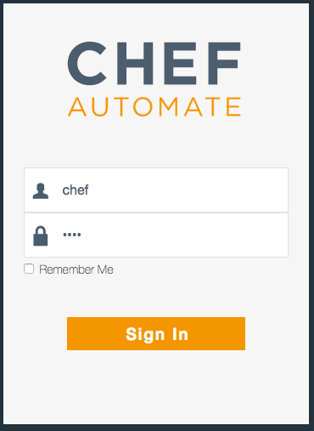
Login to Chef Automate
https://informatica-compliance-workshop.chefdemo.net
Uses a self-signed certificate in this lab
Username: chef
Password: chef
Notes:
>>> INSTRUCTOR NOTE:
Insert the URL of the Chef Automate Server
Walk participants through accepting the self-signed certificate

Slide 19
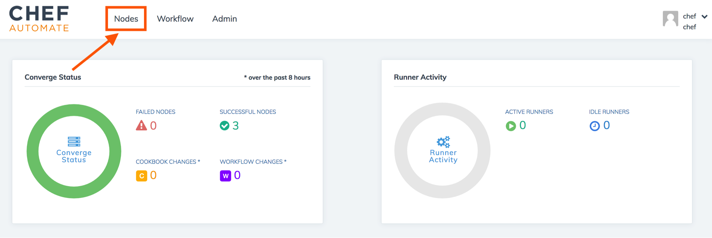
Browse to your node

Slide 20
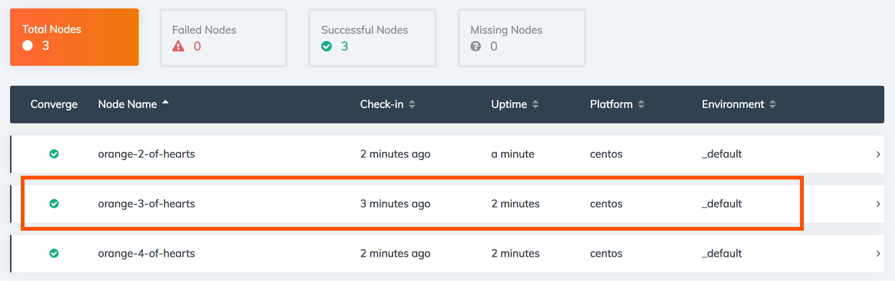
Browse to your node
Notes:
>>> INSTRUCTOR NOTE – You might want to use the orange 3 of hearts as your card, or at least, the 3 of hearts
The slides will use the orange 3 of hearts

Slide 21
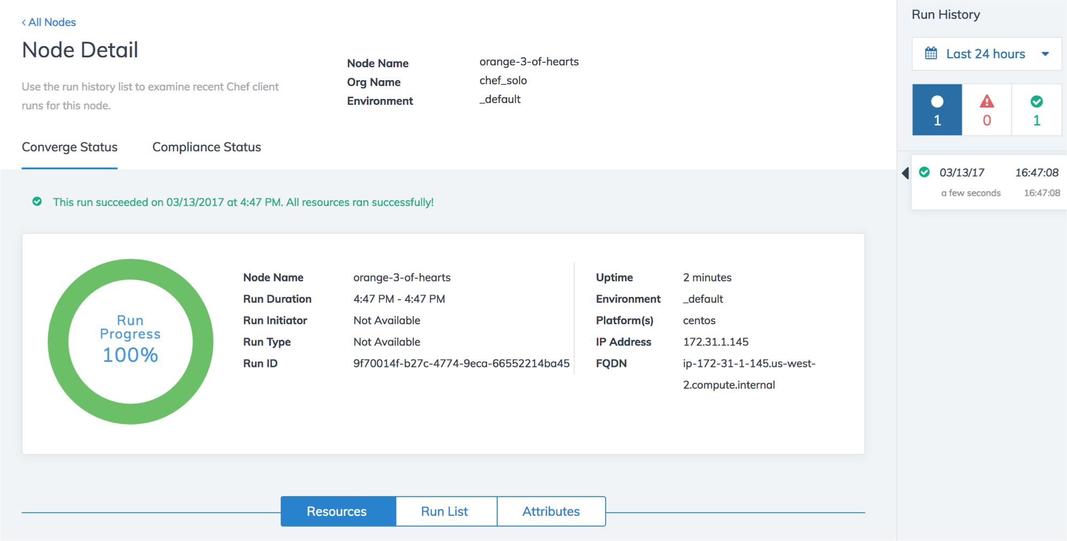
View details of your node
Notes:
>>> INSTRUCTOR NOTE – Simply browse around and show off some of the features of Automate

Slide 22
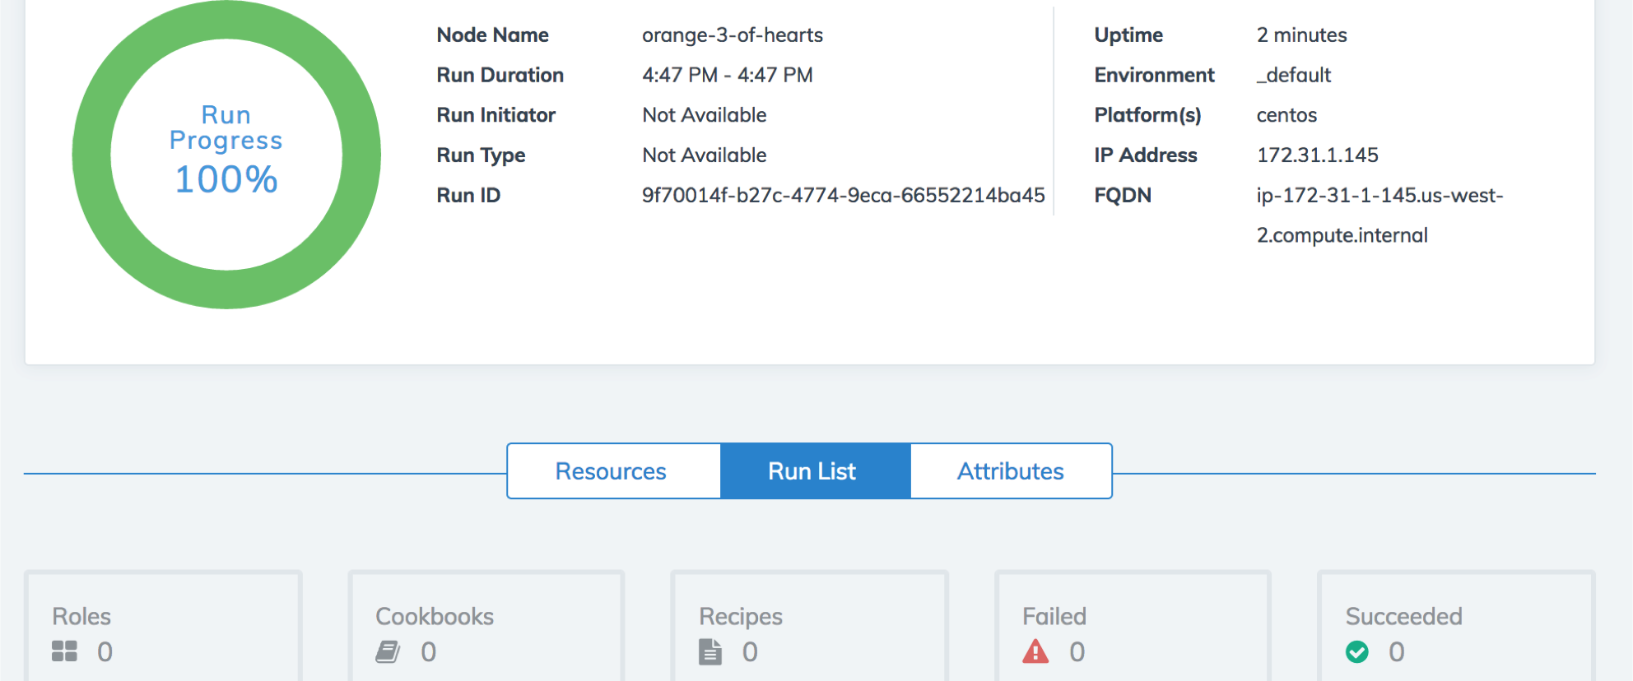
View details of your node
Notes:
>>> INSTRUCTOR NOTE – Simply browse around and show off some of the features of Automate

Slide 23
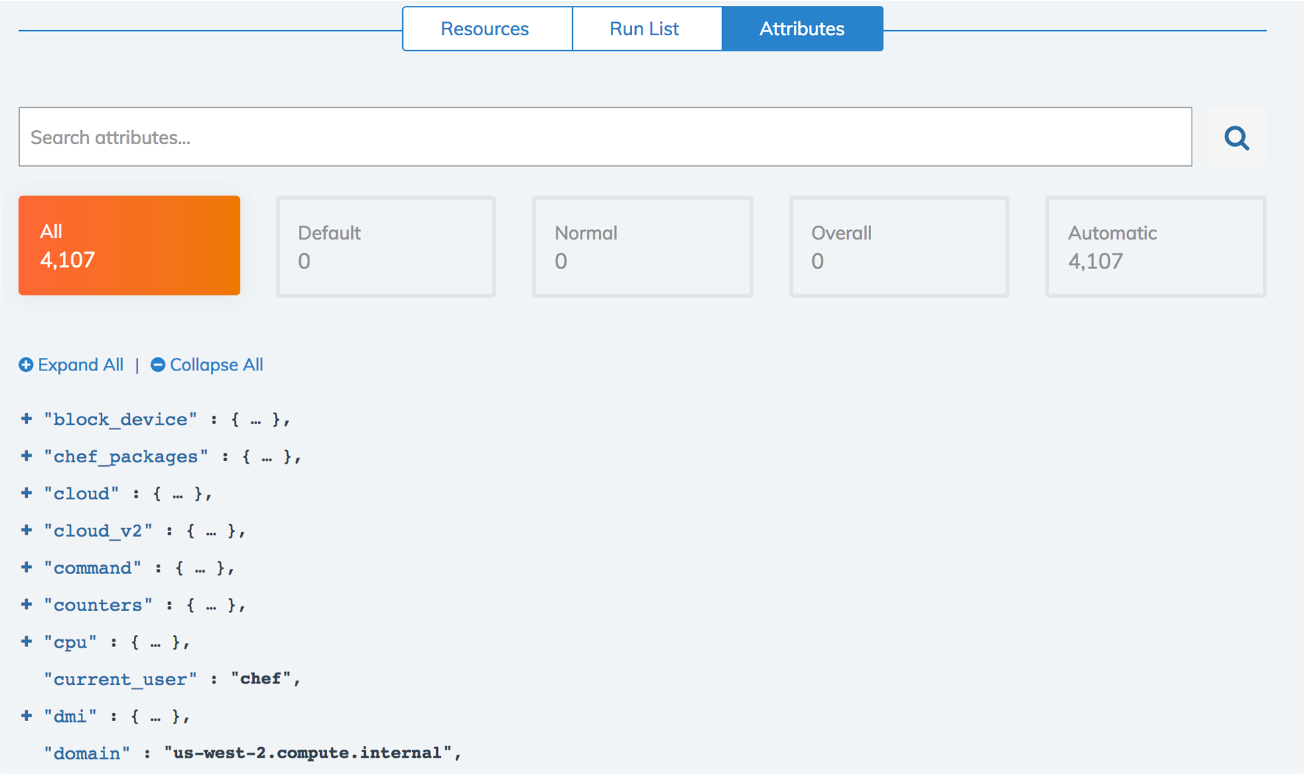
View details of your node
Notes:
>>> INSTRUCTOR NOTE – Simply browse around and show off some of the features of Automate

Slide 24
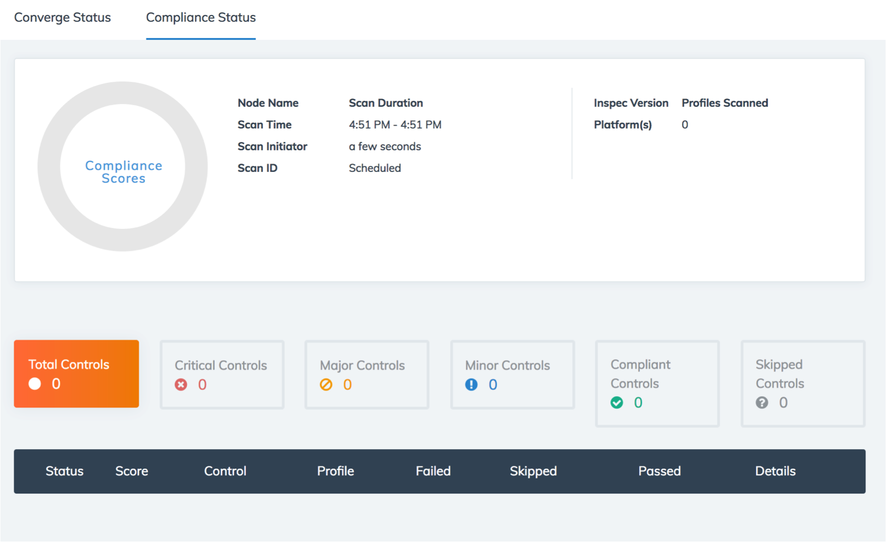
View details of your node
Notes:
>>> INSTRUCTOR NOTE – Simply browse around and show off some of the features of Automate

Slide 25
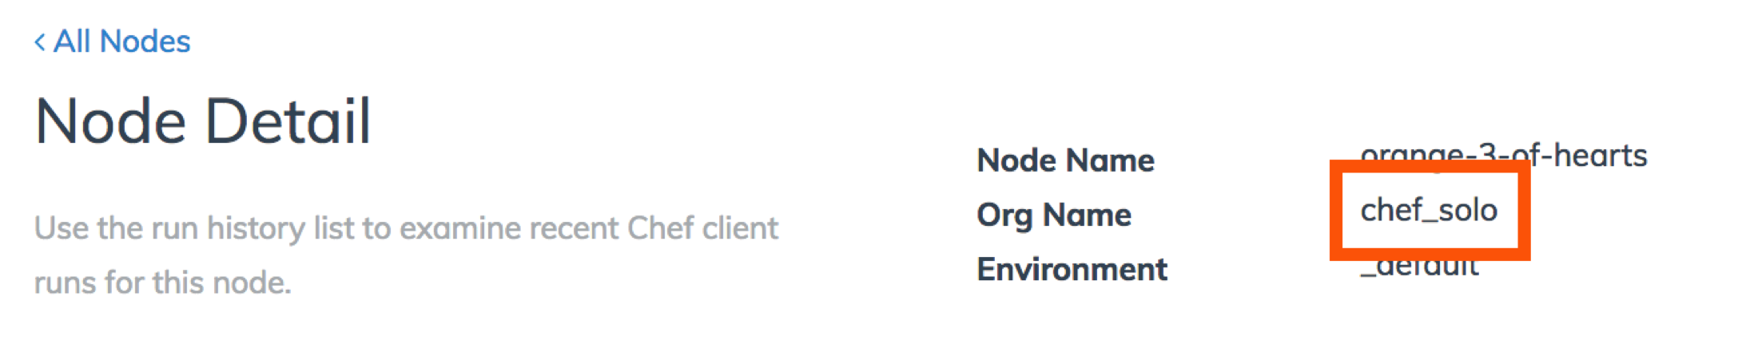
The node uses chef solo
Notes:
>>> INSTRUCTOR NOTE – Point out that we’re using Chef Solo. We’re going to run the node again, this time with a profile

Slide 26
Chef Automate – Node View
View aggregate status of your infrastructure
Overall & trend views of converge status
Overall & trend views of compliance status
Filter & search options
View details of any node
Status of converged resources
Run List applied to the node
Attributes of the node

Slide 27
Chef Solo
Executes chef-client without relying on a Chef server to provide configuration policies (cookbooks, environments, etc.)
https://docs.chef.io/chef_solo.html

Slide 28
Chef Solo
Local directory for configuration policy
Or a URL from which a .tar.gz file can be downloaded
Node objects stored as a local JSON file
Attribute data stored in a JSON file
Local or remote
Does not pull from a Chef Server
Can be configured to send data to a Chef Server
Notes:
Describe some of the differences between chef-client and chef-solo
Next, we’ll look at our own chef-solo setup

Slide 29
Chef Client – Local Mode
Local mode is a way to run the chef-client against the chef-repo on a local machine as if it were running against the Chef server.
https://docs.chef.io/ctl_chef_client.html#run-in-local-mode
Notes:
Chef Client is local mode acts in a very similar way to chef-solo. The Automate server does not distinguish between chef-solo and chef-client --local-mode

Slide 30
Go home
cd ~

Slide 31
Run chef-client in local mode
sudo run_chef
[2017-03-10T14:05:49+00:00] INFO: Forking chef instance to converge...
Starting Chef Client, version 12.18.31
...
Converging 0 resources
[2017-03-10T14:05:51+00:00] INFO: Chef Run complete in 0.19413018 seconds
Running handlers:
[2017-03-10T14:05:51+00:00] INFO: Running report handlers
Running handlers complete
[2017-03-10T14:05:51+00:00] INFO: Report handlers complete
Chef Client finished, 0/0 resources updated in 01 seconds
Notes:
sudo chef-client --local-mode
Review the output with participants
There is no run list, so no resources are updated

Slide 32
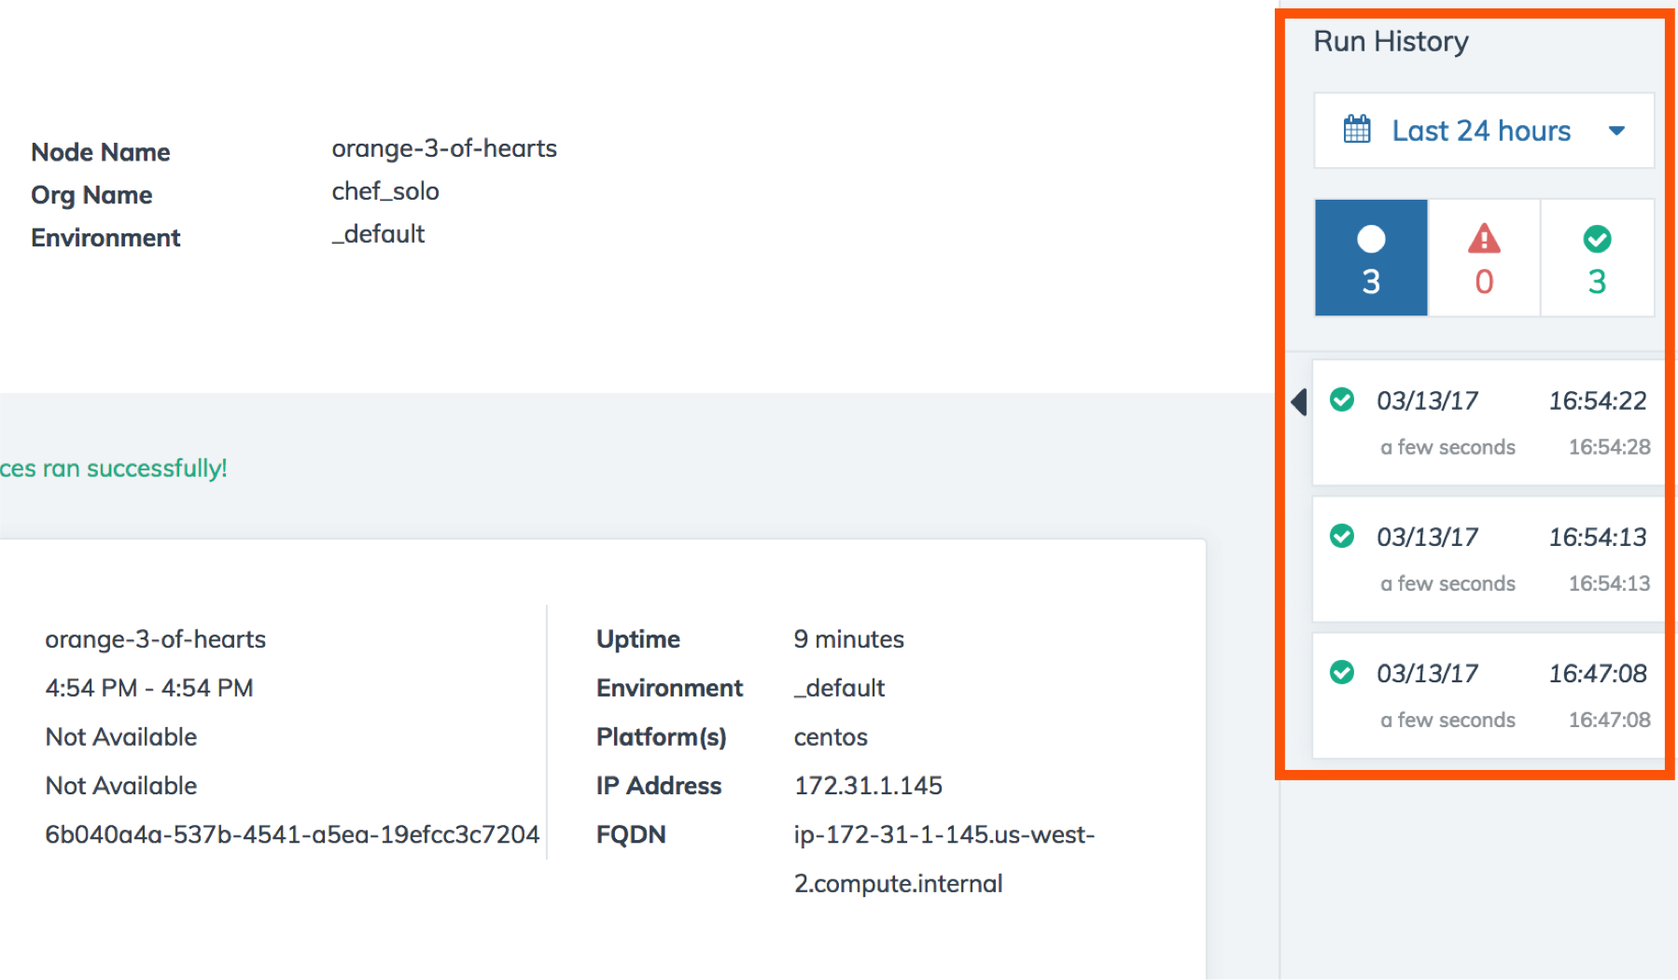
Check the converge status in Automate

Slide 33
Run with additional parameters
sudo run_chef "recipe[audit::default]"
[2017-03-10T14:10:34+00:00] INFO: Forking chef instance to converge...
Starting Chef Client, version 12.18.31
[2017-03-10T14:10:34+00:00] INFO: *** Chef 12.18.31 ***
...
[2017-03-10T14:10:40+00:00] INFO: Chef Run complete in 4.10402964 seconds
Running handlers:
[2017-03-10T14:10:40+00:00] INFO: Running report handlers
[2017-03-10T14:10:40+00:00] WARN: Format is json
[2017-03-10T14:10:40+00:00] INFO: Initialize InSpec
[2017-03-10T14:10:40+00:00] INFO: Running tests from: [{:name=>"ssh", :path=>"/home/chef/profiles/ssh"}]
[2017-03-10T14:10:40+00:00] INFO: Reporting to chef-visibility
...
Running handlers complete
[2017-03-10T14:10:40+00:00] INFO: Report handlers complete
Chef Client finished, 1/2 resources updated in 06 seconds
Notes:
sudo chef-client --local-mode -j config.json -r "recipe[audit::default]"

Slide 34
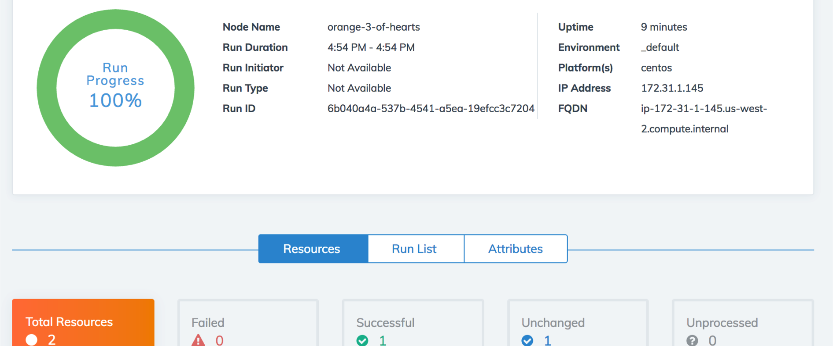
Check the converge status in Automate

Slide 35
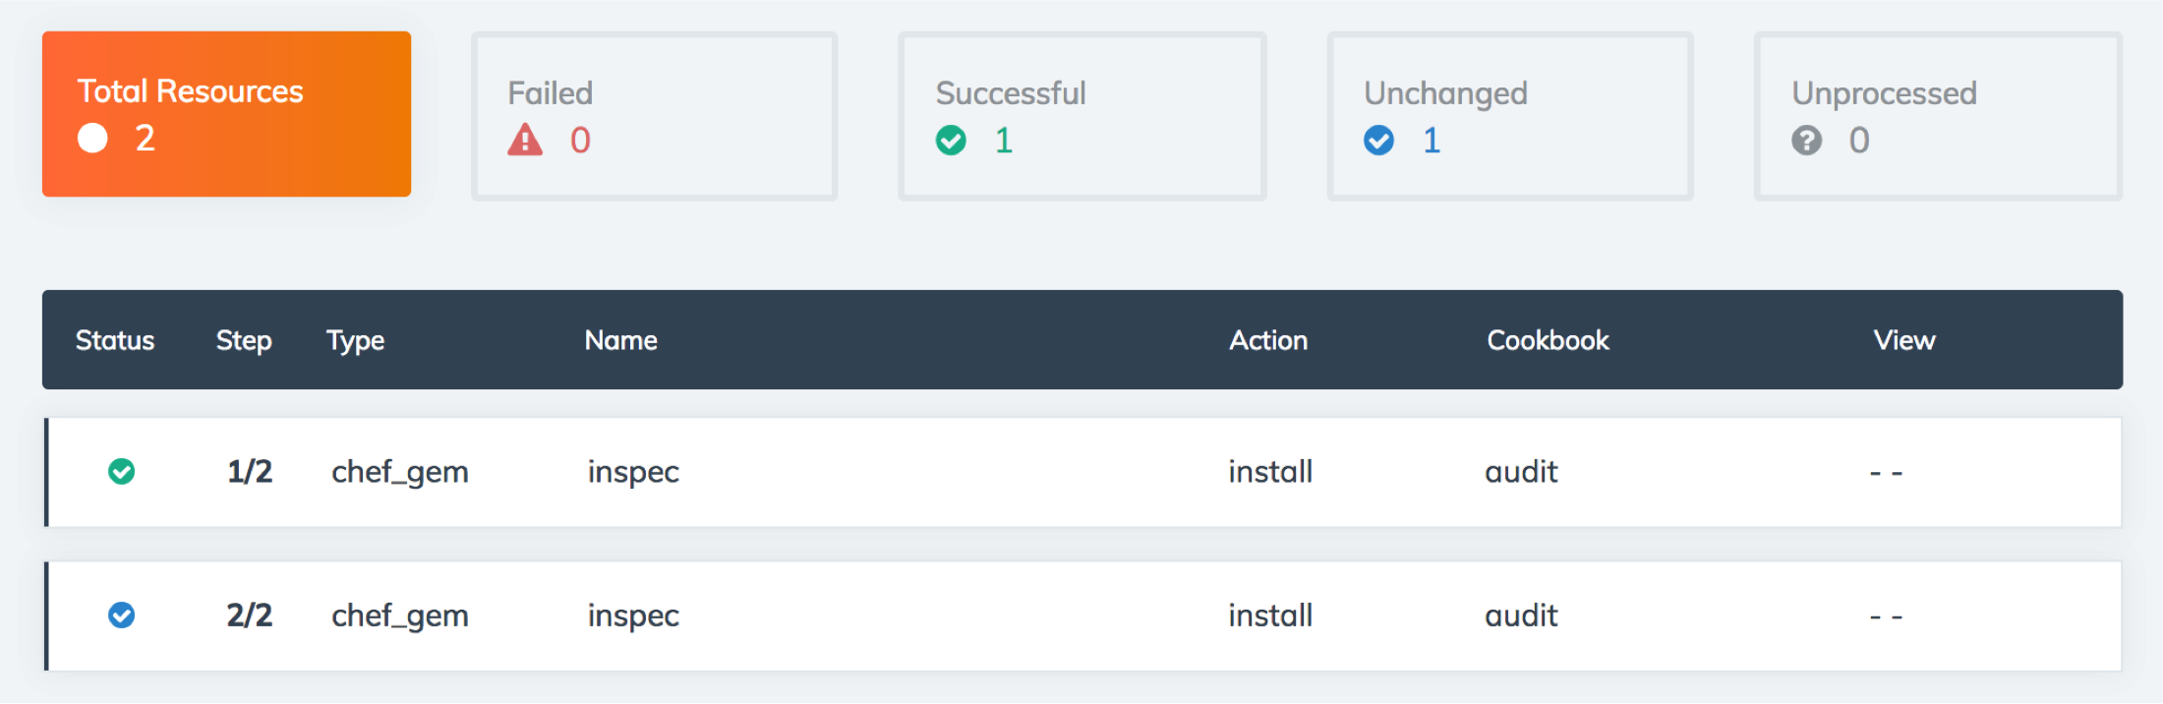
Check the converge status in Automate

Slide 36
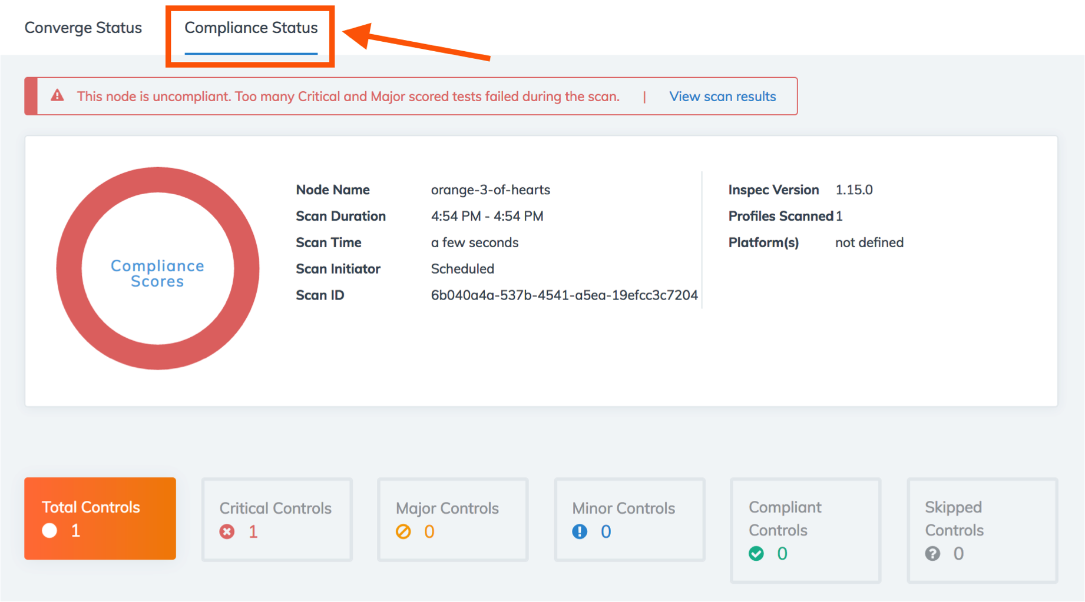
Check the compliance status in Automate

Slide 37
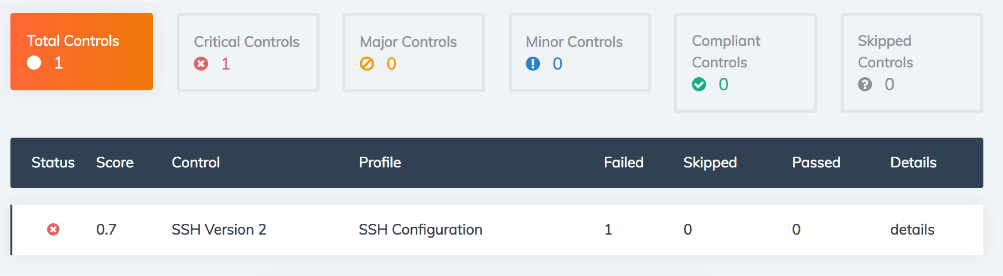
Check the compliance status in Automate

Slide 38
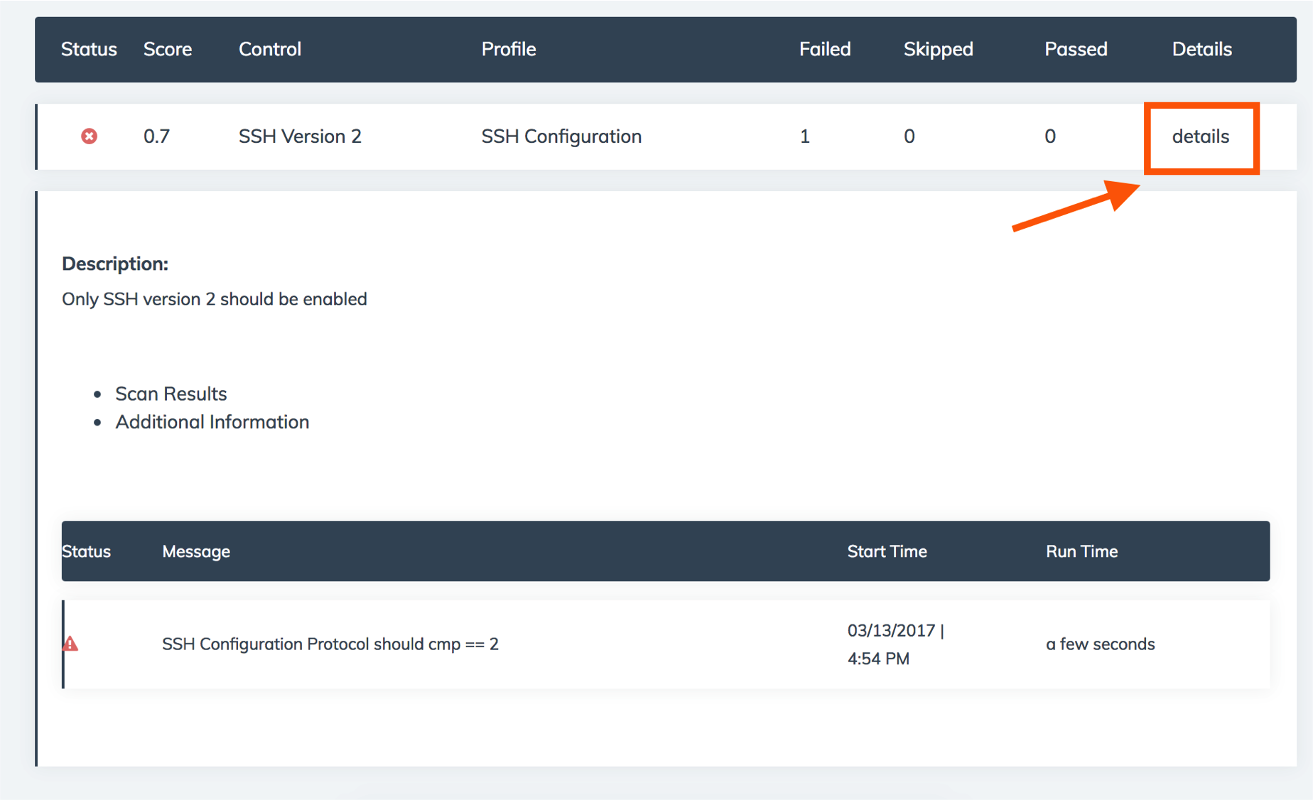
View details of the failing control

Slide 39
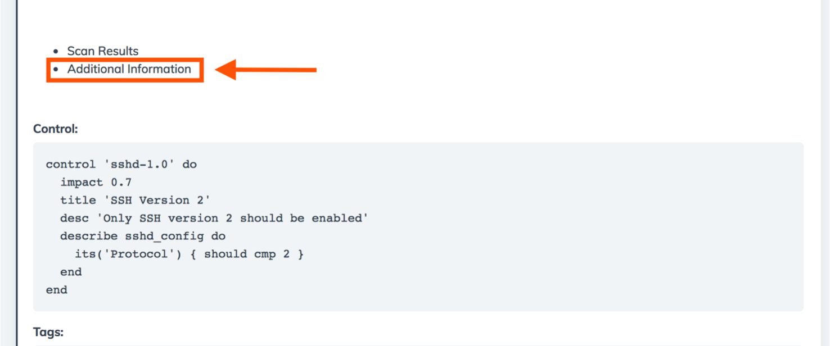
View details of the failing control

Slide 40
Review the set-up
tying it all together

Slide 41
Go home
cd ~

Slide 42
List contents
ls
Berksfile config.json firstname-lastname profiles
Berksfile.lock cookbooks nodes

Slide 43
List cookbooks
ls cookbooks
audit compat_resource

Slide 44
Audit Cookbook
Install InSpec
Run InSpec profiles
Report results to Chef Compliance or Chef Automate

Slide 45
Compat Resource Cookbook
Adds functionality introduced in the latest chef-client releases to any chef-client from 12.1 onwards.
Includes
Custom Resource functionality
notification improvements
new resources added to core chef
Allows for these new resources in cookbooks without requiring the very latest Chef client release.

Slide 46
config.json
cat config.json
{
"audit": {
"collector": "chef-visibility",
"inspec_version": "1.15.0",
"profiles": [
{
"name": "ssh",
"path": "/home/chef/profiles/ssh"
}
]
}
}
Notes:
Node-specific attributes are specified in a JSON file.
These attributes are used by the audit cookbook.

Slide 47
Local Profiles
tree profiles
profiles/
└── ssh
├── controls
│ └── ssh.rb
├── inspec.lock
└── inspec.yml
2 directories, 3 files

Slide 48
Run Locally with InSpec
inspec exec profiles/ssh
Profile: SSH Configuration (ssh)
Version: 0.1.0
Target: local://
× sshd-1.0: SSH Version 2 (
expected: 2
got:
(compared using `cmp` matcher)
)
× SSH Configuration Protocol should cmp == 2
expected: 2
got:
(compared using `cmp` matcher)
Profile Summary: 0 successful, 1 failures, 0 skipped
Test Summary: 0 successful, 1 failures, 0 skipped

Slide 49
Next Steps
Remediate the failing control
Run the audit cookbook to verify the remediation
View the compliant node in Automate

Slide 50
Remediate the Failing Control

Slide 51
Fix your ssh configuration on your own
Write a cookbook to manage SSH
Manually update the SSH configuration
Notes:
Depending on time and experience with Chef you can do either thing next

Slide 52
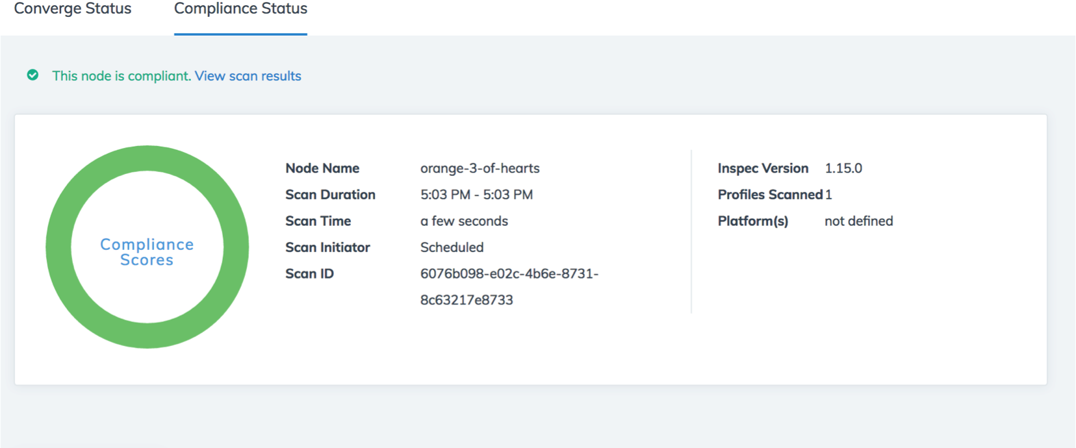
Verify Compliance Status in Automate

Slide 53
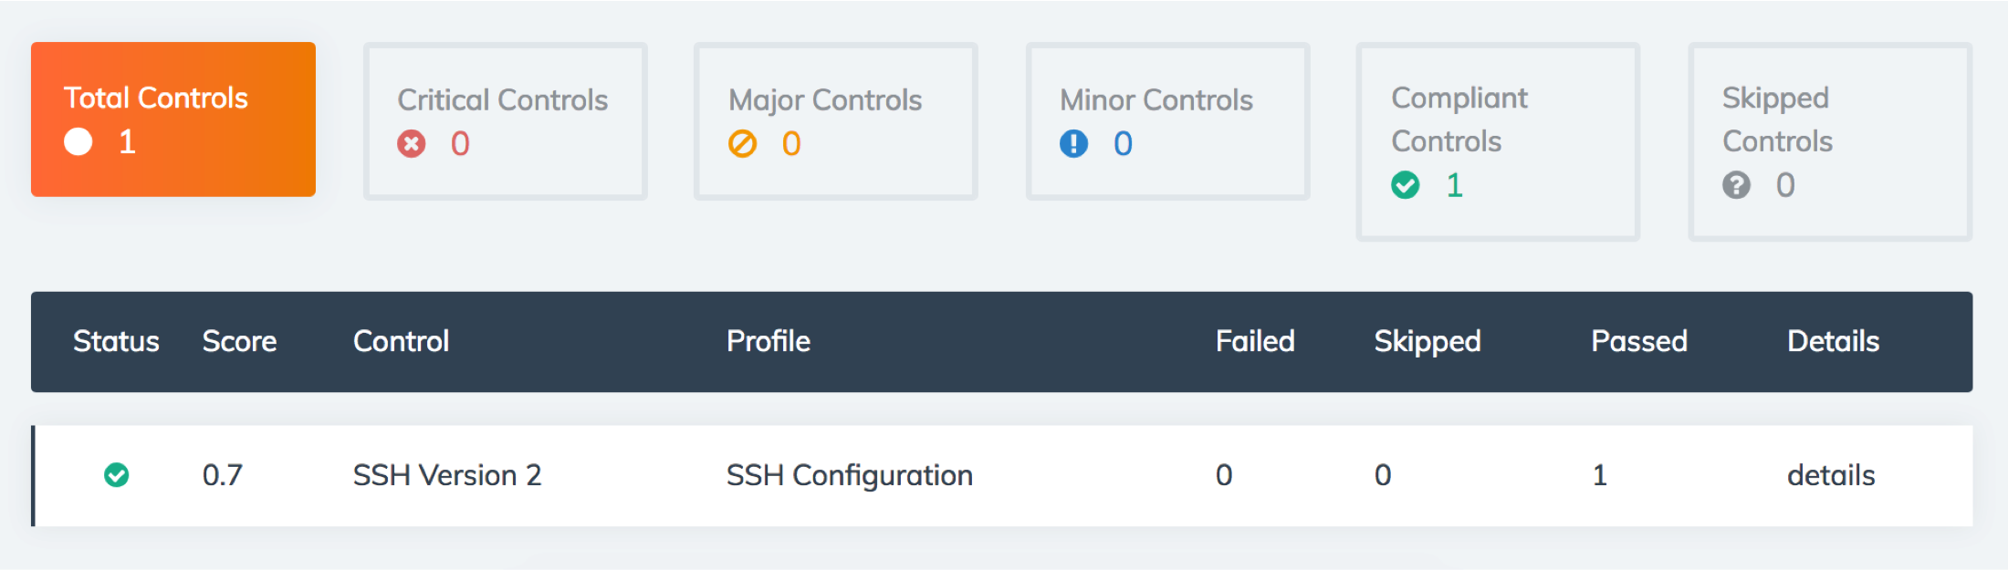
Verify Compliance Status in Automate

Slide 54
Remediate Failing SSH Control

Slide 55
Simple SSH Cookbook
A server recipe to manage the sshd_config file
Local test environment configured

Slide 56
Move to the cookbooks directory
cd ~/cookbooks

Slide 57
Generate an ssh cookbook
chef generate cookbook ssh
Generating cookbook ssh
- Ensuring correct cookbook file content
- Committing cookbook files to git
- Ensuring delivery configuration
- Ensuring correct delivery build cookbook content
- Adding delivery configuration to feature branch
- Adding build cookbook to feature branch
- Merging delivery content feature branch to master
Your cookbook is ready. Type `cd ssh` to enter it.
There are several commands you can run to get started locally developing and testing your cookbook.
Type `delivery local --help` to see a full list.
Why not start by writing a test? Tests for the default recipe are stored at:
test/smoke/default/default_test.rb
If you'd prefer to dive right in, the default recipe can be found at:
recipes/default.rb

Slide 58
Add a server recipe to the ssh cookbook
chef generate recipe ssh server
Recipe: code_generator::recipe
* directory[./ssh/spec/unit/recipes] action create (up to date)
* cookbook_file[./ssh/spec/spec_helper.rb] action create_if_missing (up to date)
* template[./ssh/spec/unit/recipes/server_spec.rb] action create_if_missing
- create new file ./ssh/spec/unit/recipes/server_spec.rb
- update content in file ./ssh/spec/unit/recipes/server_spec.rb from none to d14960
(diff output suppressed by config)
* directory[./ssh/test/smoke/default] action create (up to date)
* template[./ssh/test/smoke/default/server.rb] action create_if_missing
- create new file ./ssh/test/smoke/default/server.rb
- update content in file ./ssh/test/smoke/default/server.rb from none to aa8bba
(diff output suppressed by config)
* template[./ssh/recipes/server.rb] action create
- create new file ./ssh/recipes/server.rb
- update content in file ./ssh/recipes/server.rb from none to 18f24e
(diff output suppressed by config)

Slide 59
Add a template to the cookbook
chef generate template ssh sshd_config -s /etc/ssh/sshd_config
Recipe: code_generator::template
* directory[./ssh/templates/default] action create
- create new directory ./ssh/templates/default
* file[./ssh/templates/sshd_config.erb] action create
- create new file ./ssh/templates/sshd_config.erb
- update content in file ./ssh/templates/sshd_config.erb from none to a16b11
(diff output suppressed by config)

Slide 60
Server Recipe
~/cookbooks/ssh/recipes/server.rb
template '/etc/ssh/sshd_config' do
source 'sshd_config.erb'
owner 'root'
group 'root'
mode '0600'
end

Slide 61


Remember…
Infrastructure policies need testing
↳ Linting
↳ Static Analysis
↳ Unit Testing
↳ Integration Testing ↳ Compliance Testing
"Infrastructure as Code" should be tested like ANY other codebase.

Slide 62
Test-driven Development
Write a test, watch it fail
Write some code
Write and run more tests
Code review
Delivery pipeline to production
Lowered chance of production failure
Add a test
pass
Run the tests
fail
Make a little change
pass
[development continues]
fail
Run the tests
pass
[development stops]

Slide 63
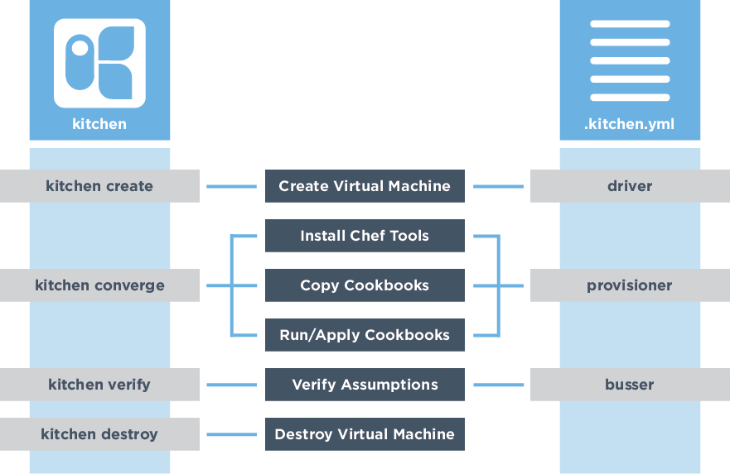




Testing the change

Slide 64
Test Kitchen Configuration (1 of 3)
~/cookbooks/ssh/.kitchen.yml
---
driver:
name: vagrant
name: docker
...
-
+
Notes:
Switch the driver to docker

Slide 65
Test Kitchen Configuration (2 of 3)
~/cookbooks/ssh/.kitchen.yml
...
platforms:
- name: ubuntu-16.04
- name: centos-7.2
- name: centos-7.3
...
-
-
+
Notes:
Update the platform, we’ll just check CentOS 7.3

Slide 66
Test Kitchen Configuration (3 of 3)
~/cookbooks/ssh/.kitchen.yml
suites:
- name: default
- name: server
run_list:
- recipe[ssh::default]
- recipe[ssh::server]
verifier:
inspec_tests:
- test/smoke/default
- /home/chef/profiles/ssh
attributes:
-
+
-
+
-
+
Notes:
Update the platform, we’ll just check CentOS 7.3

Slide 67
Move to the cookbook’s directory
cd ~/cookbooks/ssh

Slide 68
List the kitchens
kitchen list
Instance Driver Provisioner Verifier Transport Last Action Last Error
server-centos-73 Docker ChefZero Inspec Ssh <Not Created> <None>

Slide 69
Converge
kitchen converge
-----> Starting Kitchen (v1.15.0)
...
-----> Creating <server-centos-73>...
Sending build context to Docker daemon 227.8 kB
Sending build context to Docker daemon
Step 0 : FROM centos:centos7
...
Running handlers:
[2017-03-12T02:26:16+00:00] INFO: Running report handlers
Running handlers complete
[2017-03-12T02:26:16+00:00] INFO: Report handlers complete
Chef Client finished, 1/1 resources updated in 01 seconds
Finished converging <server-centos-73> (0m23.54s).
-----> Kitchen is finished. (1m0.39s)

Slide 70
Test-driven Development
Add a test
pass
Run the tests
fail
Make a little change
pass
[development continues]
fail
Run the tests
pass
[development stops]
Notes:
Technically, we haven’t written any tests just yet. However, one could argue that a passing ‘kitchen converge’ is, itself, a worthwhile test.
By setting up test kitchen we’ve not added a test, run the test, seen the tests pass. But we’re not done so it’s time to restart the loop.

Slide 71
Verify the Kitchen
kitchen verify
-----> Verifying <server-centos-73>...
Loaded
Target: ssh://kitchen@localhost:32771
× sshd-1.0: SSH Version 2 (
expected: 2
got:
(compared using `cmp` matcher)
)
× SSH Configuration Protocol should cmp == 2
expected: 2
got:
(compared using `cmp` matcher)
Profile Summary: 0 successful, 1 failures, 0 skipped
Test Summary: 0 successful, 1 failures, 0 skipped

Slide 72
Test-driven Development
Add a test
pass
Run the tests
fail
Make a little change
Notes:
Technically, we haven’t written any tests just yet. However, one could argue that a passing ‘kitchen converge’ is, itself, a worthwhile test.
By setting up test kitchen we’ve not added a test, run the test, seen the tests pass. But we’re not done so it’s time to restart the loop.

Slide 73
Edit the SSH Configuration Template
~/cookbooks/ssh/templates/sshd_config.erb
#ListenAddress 0.0.0.0
#ListenAddress ::
# The default requires explicit activation of protocol 1
#Protocol 2
Protocol 2
# HostKey for protocol version 1
-
+

Slide 74
Test-driven Development
Add a test
pass
Run the tests
fail
Make a little change
pass
[development continues]
fail
Run the tests
pass
[development stops]
Notes:
Technically, we haven’t written any tests just yet. However, one could argue that a passing ‘kitchen converge’ is, itself, a worthwhile test.
By setting up test kitchen we’ve not added a test, run the test, seen the tests pass. But we’re not done so it’s time to restart the loop.

Slide 75
Converge
kitchen converge
-----> Starting Kitchen (v1.15.0)
...
-----> Converging <server-centos-73>...
...
# The default requires explicit activation of protocol 1
-#Protocol 2
+Protocol 2
# HostKey for protocol version 1
...
Running handlers:
[2017-03-12T02:32:32+00:00] INFO: Running report handlers
Running handlers complete
[2017-03-12T02:32:32+00:00] INFO: Report handlers complete
Chef Client finished, 1/1 resources updated in 01 seconds
Finished converging <server-centos-73> (0m16.32s).
-----> Kitchen is finished. (0m17.34s)

Slide 76
Verify the Kitchen
kitchen verify
-----> Starting Kitchen (v1.15.0)
...
-----> Verifying <server-centos-73>...
Loaded
Target: ssh://kitchen@localhost:32771
✔ sshd-1.0: SSH Version 2
✔ SSH Configuration Protocol should cmp == 2
Profile Summary: 1 successful, 0 failures, 0 skipped
Test Summary: 1 successful, 0 failures, 0 skipped
Finished verifying <server-centos-73> (0m0.22s).
-----> Kitchen is finished. (0m1.27s)

Slide 77
Test-driven Development
Add a test
pass
Run the tests
fail
Make a little change
pass
[development continues]
fail
Run the tests
pass
[development stops]
Notes:
We’ve completed the cycle. But are we done?

Slide 78
Test the Kitchen (1of 2)
kitchen test
-----> Starting Kitchen (v1.15.0)
...
-----> Cleaning up any prior instances of <server-centos-73>
-----> Destroying <server-centos-73>...
...
-----> Testing <server-centos-73>
-----> Creating <server-centos-73>...
...
-----> Creating <server-centos-73>...
...
Finished creating <server-centos-73> (0m0.60s).
-----> Converging <server-centos-73>...
...

Slide 79
Test the Kitchen (2 of 2)
kitchen test
-----> Installing Chef Omnibus (install only if missing)
...
-----> Setting up <server-centos-73>...
Finished setting up <server-centos-73> (0m0.00s).
-----> Verifying <server-centos-73>...
...
Profile Summary: 1 successful, 0 failures, 0 skipped
Test Summary: 1 successful, 0 failures, 0 skipped
Finished verifying <server-centos-73> (0m0.51s).
-----> Destroying <server-centos-73>...
...
-----> Kitchen is finished. (0m25.18s)

Slide 80
What’s next?
Test-driven development cycle is complete
Deploy the change

Slide 81
Remediate with Chef
sudo run_chef "recipe[ssh::server],recipe[audit::default]"
[2017-03-10T16:48:02+00:00] INFO: Forking chef instance to converge...
Starting Chef Client, version 12.18.31
...
Synchronizing Cookbooks:
- ssh (0.1.0)
- audit (2.4.0)
- compat_resource (12.16.3)
...
-#Protocol 2
+Protocol 2
...
[2017-03-10T16:48:05+00:00] INFO: Chef Run complete in 1.248588588 seconds
Running handlers:
...
[2017-03-10T16:48:05+00:00] INFO: Report handlers complete
Chef Client finished, 1/3 resources updated in 03 seconds
Notes:
sudo chef-client --local-mode -j config.json -r "recipe[ssh::server],recipe[audit::default]"

Slide 82
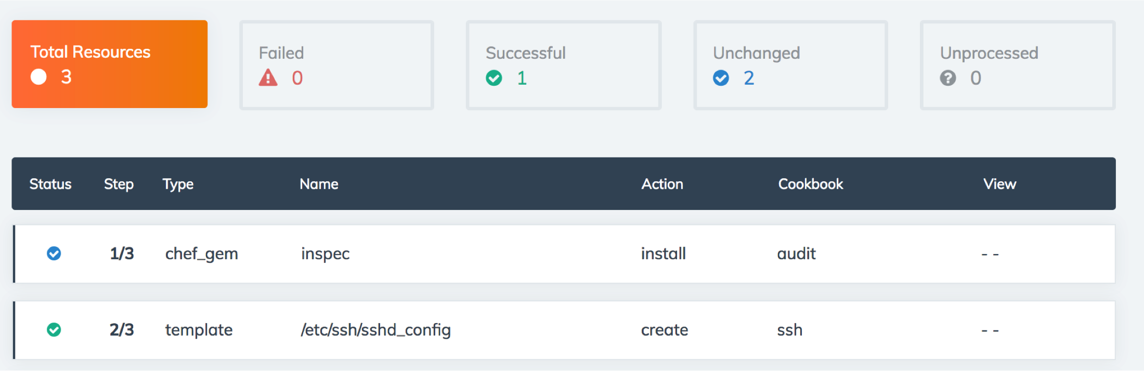
Verify Converge Status in Automate

Slide 83
Verify Compliance Status in Automate

Slide 84
Verify Compliance Status in Automate

Slide 85
More hands-on Exercises
Still have time to play around?

Slide 86
Server SSH Key
Write a control that:
Tests for the existence of /etc/ssh/ssh_host_rsa_key
Tests that /etc/ssh/ssh_host_rsa_key contains “BEGIN RSA PRIVATE KEY”
Check out the docs on http://inspec.io for what InSpec resource you can use

Slide 87
Ensure SSH root login is disabled
The PermitRootLogin parameter specifies if the root user can log in using ssh(1). The default is no.
Disallowing root logins over SSH requires system admins to authenticate using their own individual account, then escalating to root via sudo or su. This in turn limits opportunity for non-repudiation and provides a clear audit trail in the event of a security incident
Add a control to ~/profiles/ssh/controls/ssh.rb

Slide 88
Supermarket Profiles
List profiles available on the Supermarket
View information about the dev-sec/ssh-baseline profile
Execute the dev-sec/ssh-baseline profile from the Supermarket
Write a cookbook to remediate failing controls from dev-sec/ssh-baseline
Or look at the ssh-hardening cookbook

Slide 89
Build additional CIS controls
https://github.com/chef-training/workshops/tree/master/InSpec

Slide 90
Static Analysis
Ensure cookbooks pass chefstyle
Ensure cookbooks pass foodcritic

Slide 91
Unit Testing
Add unit testing to the cookbooks

Slide 92
Further Resources
Where to go for additional help

Slide 93
Community Resources
InSpec Website, includes tutorials and docs - http://inspec.io/
#inspec channel of the Chef Community Slack - http://community-slack.chef.io/
InSpec category of the Chef Mailing List - https://discourse.chef.io/c/inspec
Compliance Profiles on the Supermarket - https://supermarket.chef.io/tools?type=compliance_profile
Open Source Project - https://github.com/chef/inspec

Slide 94



DAY 1 // MAY 22
DAY 2 // MAY 23
DAY 3 // MAY 24
DAY 4 // MAY 25
Workshops & Chef Training
DevOps Leadership Summit
Community Summit
Partner Summit
Welcome Reception
Customer Dinner
Analyst Day
Keynotes
Technical Sessions
Happy Hour
Game Night
Executive Dinner
Keynotes
Technical Sessions
Awesome Chef Awards
Community Celebration
Hackday
• Exhibit Hall Open & Sales suites available • chefconf.chef.io •
Notes:
Texas, austin, bathroom law

Slide 95


